Slide 2
Major Project
TYPOO
End Semester Presentation
In partial fulfillment of the requirements
For the course of
Major Project 2
Under the guidance of
Mr. Abhirup Khanna
Assistant Professor
Department of Virtualization(SOCS)
Prabal Bansal | R110218104 | CSE CCVT
Raghav Jindal | R110218114 | CSE CCVT
Raman Kumar | R110218119 | CSE CCVT
Sachin Agrawal | R110218129 | CSE CCVT

Slide 3




Meet the Team
Sachin Agrawal
Raghav Jindal
Raman Kumar
Prabal Bansal
SDE @ Amazon
SDE @ SalesForce
SDE @ AIS
SDE @ CradlePoint
500067770
500067476
500068477
500068861
R110218129
R110218114
R110218119
R110218104

Slide 4
Introduction
A full-stack blogging web application made with node and express js and backend with MongoDB with all the CRUD operations. Users can register themselves and write their own blog from their dashboard and the admin will be able to feature that blog on the running website.
Project Guide

Slide 5
Literature Review
As we know that most of the platforms are build up of combination of multiple component relying on different middleware that are API’s.
Due to these API’s a lot of work get easier as a lot of complex task are handled by these middleware.
People are able to develop product in short period of time with the help of them and are able to deliver the product more quickly as compared to when they have to create the product from scratch comprising all the features as well as all the different component of a product.
Keeping that in mind and further integrating with components like Node.js which is capable of server side scripting and MongoDB capable of fetching multiple request at the same time and giving a lot of flexibility with the Database to play around , combined these we can create applications that are more reliable and useful at the same time and can be scaled at any moment of time.

Slide 6
Problem Statement
With this project we are trying to bring together communities with intellect in different fields having same interest of knowledge.
This project is open to people who wants to share their knowledge in a particular field.
To share individual thoughts on the internet.

Slide 7
Motivation
In today's world there are individuals who waste their precious time in surfing the internet in seek of knowledge of interest also there are people who really wants to invest their time in sharing their knowledge and want to contribute to society, So our platform is one stop solution for both of these two communities.
So We are making this project which will help the individuals to share their ideas and other relevant information in the platform and others who need that information can get from this platform.

Slide 8
Objectives
Now the final object here will be to make a dashboard that will let the people do ---
Register, login with Email or Phone number.
Quick login, Facebook, SMS.
Forgot password, reset password and register a new account by Email or SMS verification.
Update personal information (name, password and avatar)
Create new blog.
Comment realtime.
Pagination, search with autocomplete Mongodb

Slide 9
Methodology
Agile methodology of software development will be followed for the proposed project.
The project is divided into 12 sprints where the sprint 7 and 8 will consist of parallel development by different members of the team. Each sprint is provided ample time to complete itself as well as to maintain the product's backlog (if any). The project can accommodate changes if required at any stage of the project. The sprints 1, 2 and 3 are specifically for requirement analysis and designing of the project. One sprint is specifically designed for setting the environment like maintaining the Version Control (Git in our case) .
Each development sprint is followed by Unit Testing and an Integration Testing at the end. Sprints are also designed for the reviewing as well as retrospection part.
Overall, the time for the project is dedicated to an approach where the beginning time is dedicated towards the requirement analysis and the documentation part and during the implementation part all the team members are following their dedicated sprints cycles to implement the functionality. After the implementation, testing is to be done for the whole application. Finally, the application is deployed with the documentation.

Slide 10
Experimental Setup
VS Code : Text editor used to write and execute the source code.
Node Js : An open-source, cross-platform, back-end JavaScript runtime environment that runs on the V8 engine and executes JavaScript code outside a web browser.
GitHub : Open Source front end framework for building highly efficient and fast applications API.
MongoDb :SQL databases are used to store structured data while NoSQL databases like MongoDB are used to save unstructured data.

Slide 11
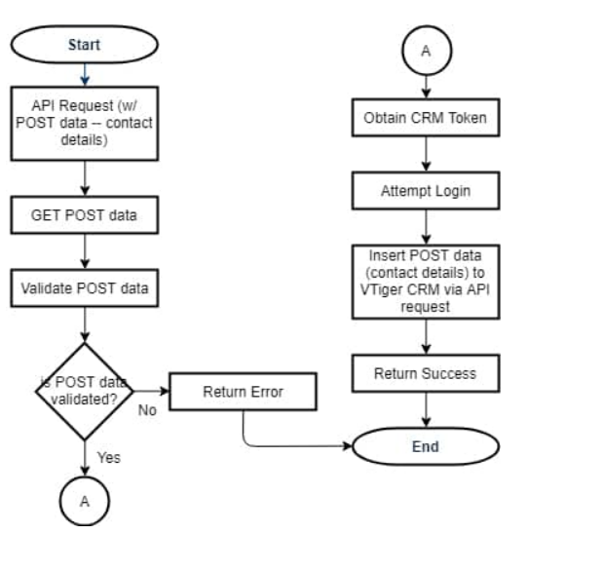
Working of API

Slide 12
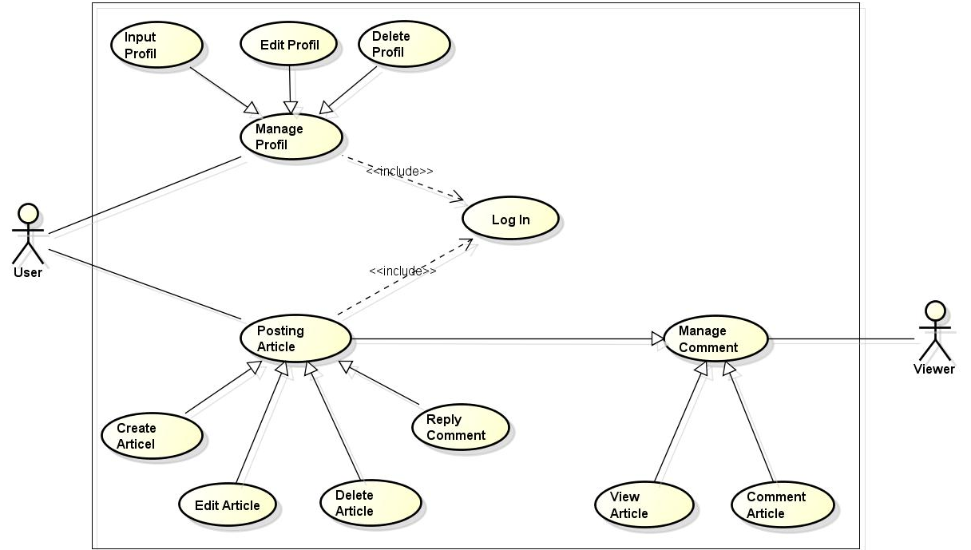
Use Case Diagram

Slide 13
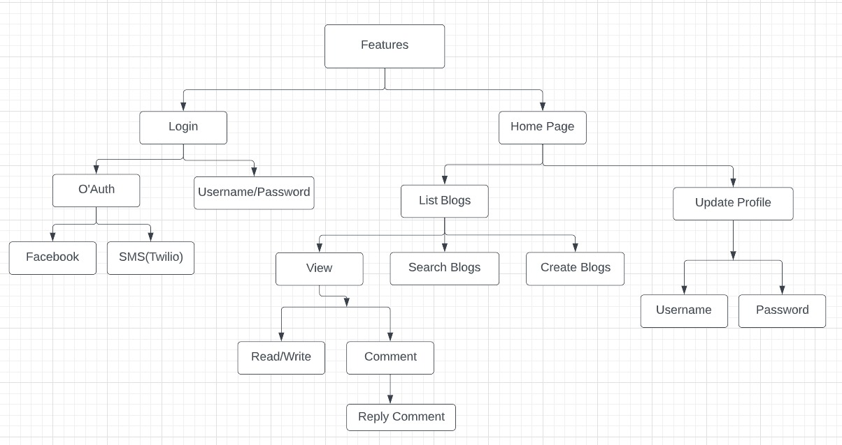
Features

Slide 14
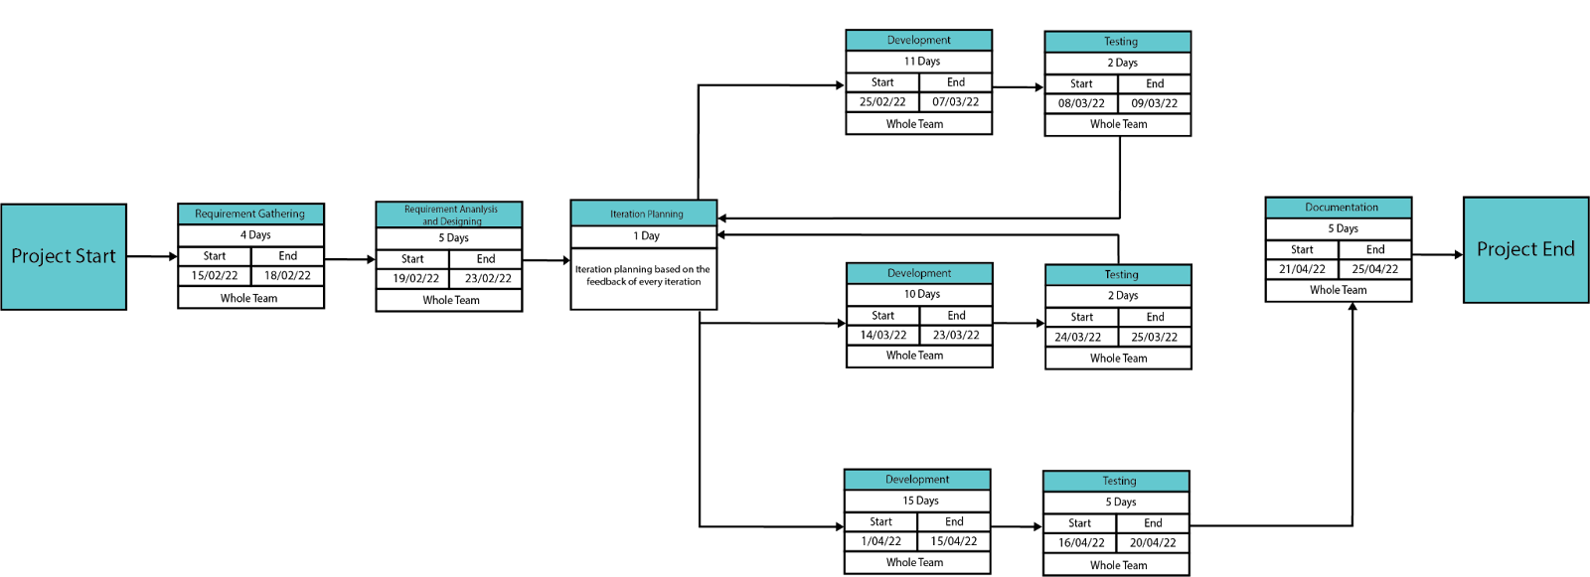
Pert Chart

Slide 15
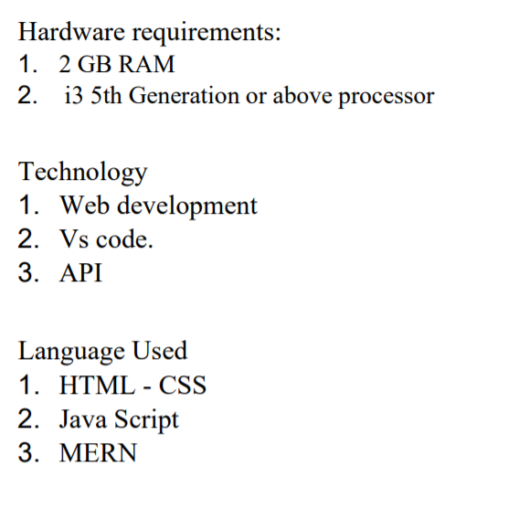
Design and Implementation Constraints

Slide 16
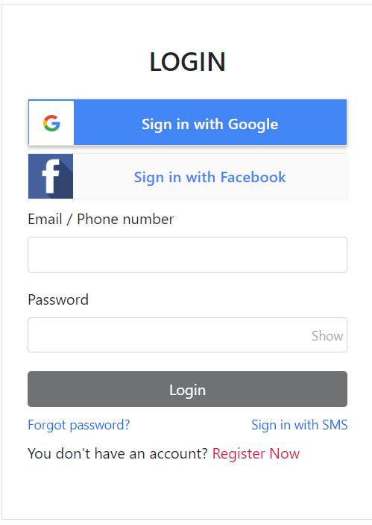
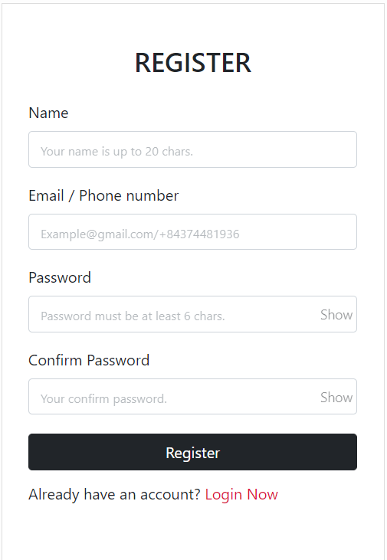
User Interface

Slide 17
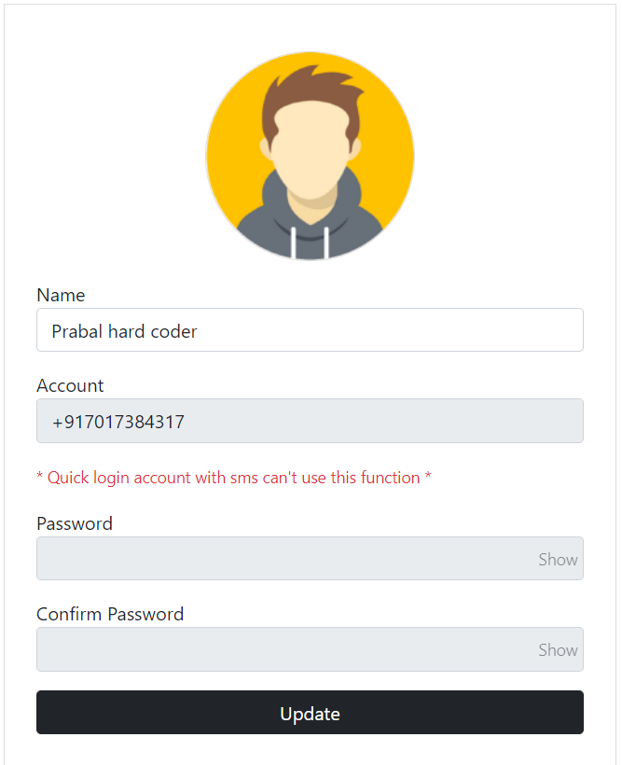
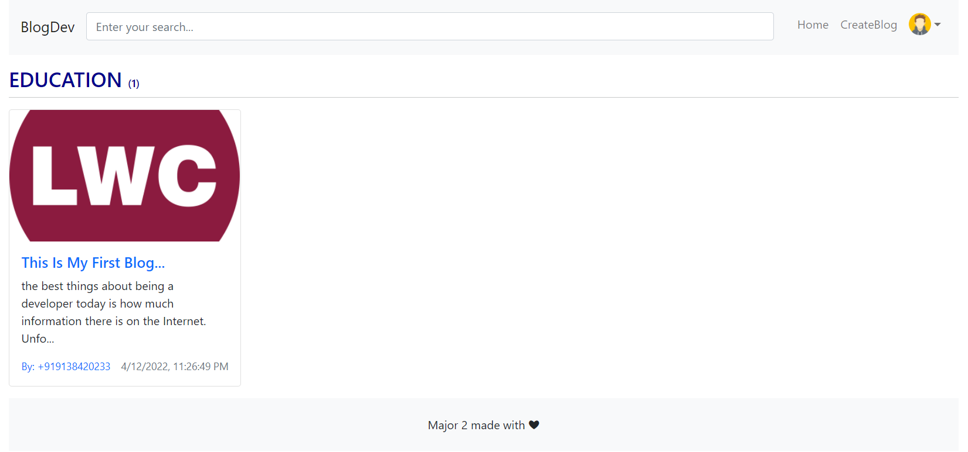
User Interface

